Slide 1
Secure Data Hiding in Image Using Steganography
CAPSTONE PROJECT
Presented By: B.Kaderavan
Student Name : B.Kaderavan
College Name & Department : Manakula Vinayagar Institute of Technology
B.Tech CSE (IOT & CyberSecurity including Blockchain Technology)

Slide 2
OUTLINE
Problem Statement
Technology used
Wow factor
End users
Result
Conclusion
Git-hub Link
Future scope

Slide 3
Problem Statement
Data security is a major concern due to increasing cyber threats.Traditional encryption methods can be detected and cracked over time.Existing steganography techniques lack advanced security and AI-based detection.The project aims to securely hide encrypted data within images using AI-powered steganography.

Slide 4
Technology used
Programming Language: Python
Libraries Used:
Pillow (Image Processing)
NumPy (Data Handling)
OpenCV (AI Image Analysis)
Cryptography (Fernet AES) (Encryption)
Tkinter (GUI)
Scikit-learn (KMeans Clustering) (Noise Detection)

Slide 5
Wow factors
Why is this project unique? AES-256 Encryption – Protects hidden data from hacking attempts. AI-Based Noise Detection – Uses machine learning (KMeans Clustering) to detect steganography. GUI Interface – A simple Tkinter-based UI for easy use. Auto-Key Generation – Automatically generates a secure key for encryption. Custom Image Saving – Users can choose where to save the encrypted image.

Slide 6
End users
Cybersecurity Experts – Securely transmit sensitive information.
Journalists & Whistleblowers – Hide confidential messages in images
.Military & Intelligence Agencies – Secure covert communication.
Blockchain & Crypto Developers – Hide cryptographic keys within images.
IoT Security Teams – Ensure secure device communication without detection.

Slide 7
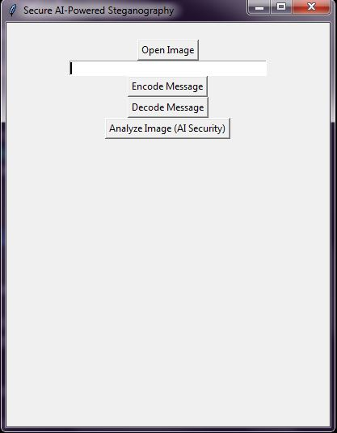

Results

Slide 8
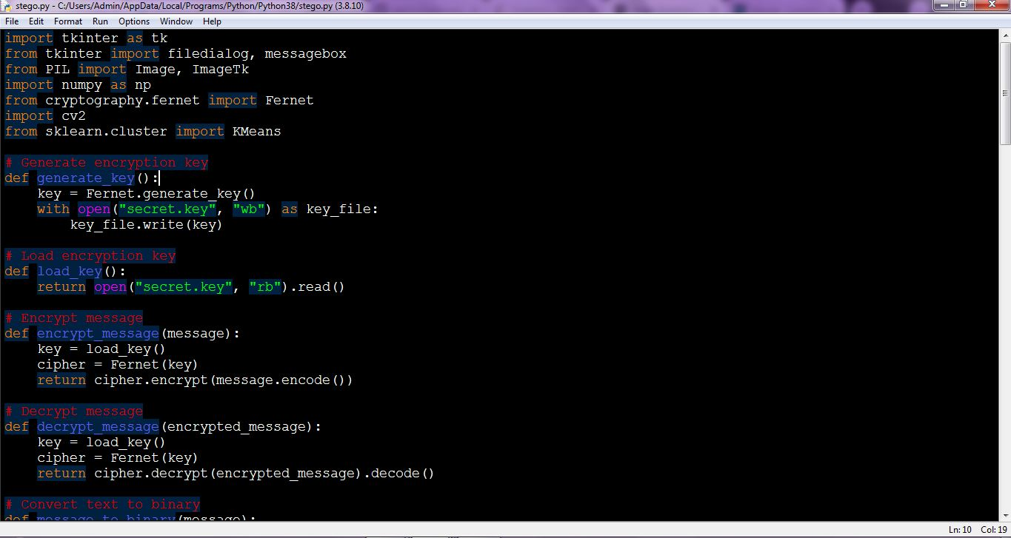
Results

Slide 9
Conclusion
Successfully secured data using AI-powered steganography.
AES encryption ensures strong security before hiding messages.
AI-based noise detection enhances security against steganalysis attacks.
The system can be further improved with quantum cryptography and blockchain authentication.

Slide 10
GitHub Link
https://github.com/leaf-0/AI-Powered-Steganography.git

Slide 11
Future scope(optional)
Quantum Cryptography Integration – Protect messages from future quantum computing attacks.
Blockchain-Based Logging – Store steganographic transactions securely.
Deep Learning for Steganalysis – Improve AI-based detection of hidden messages.
Real-time Secure Messaging – Convert into a covert chat application.
Multimedia Steganography – Extend to audio and video files.

Slide 12
THANK YOU

